Slide 1
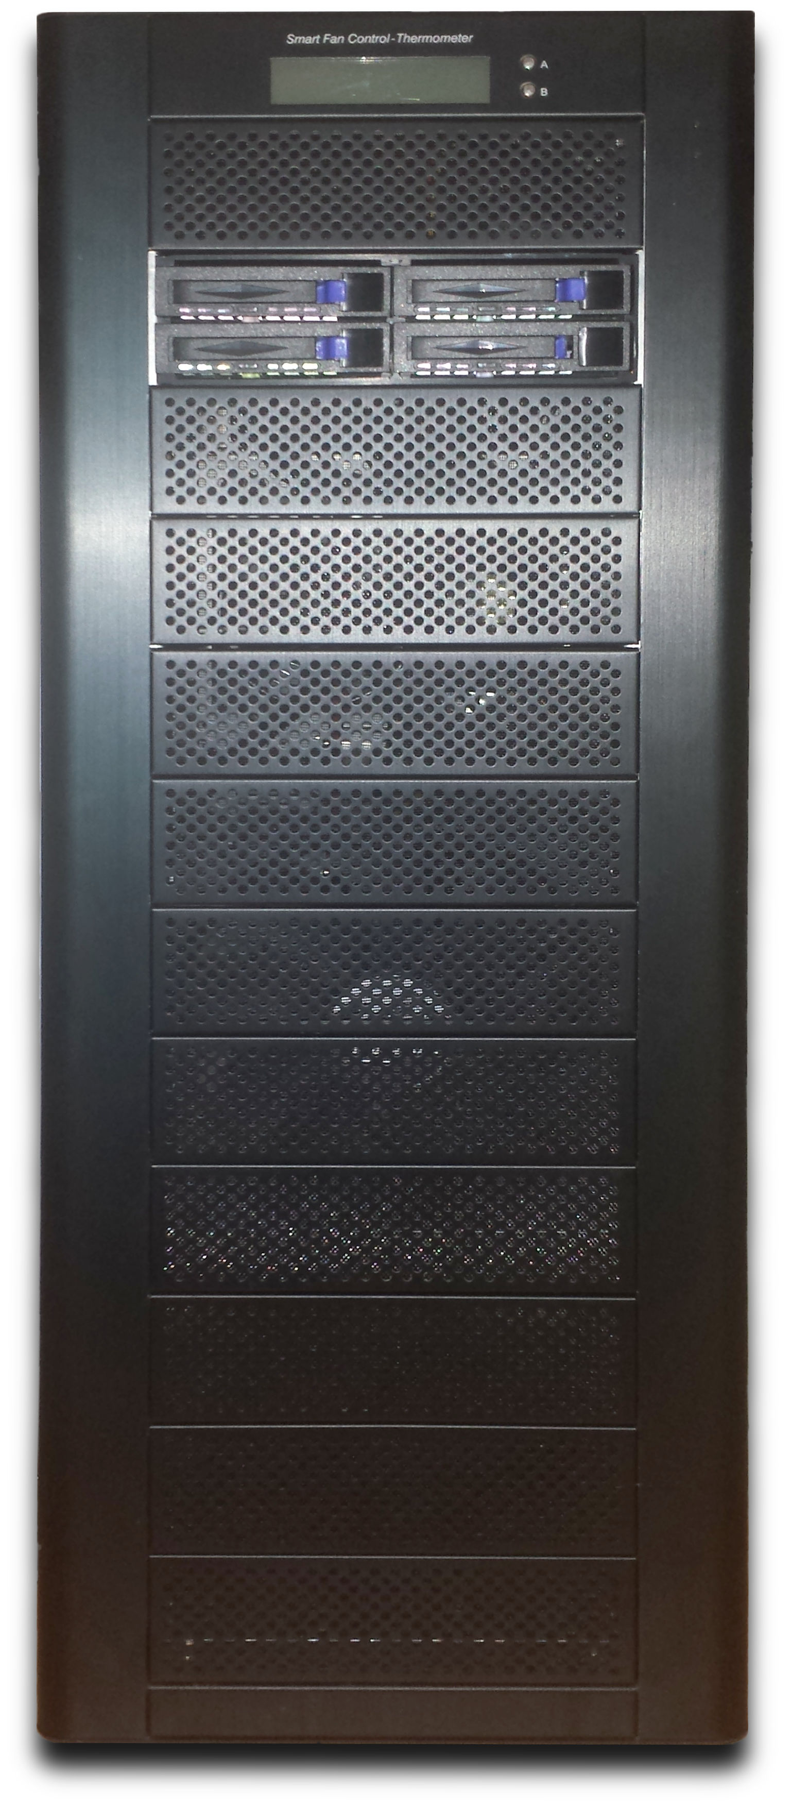
Introducing Kaasimir
GPU Testing Made Simple
Colin Finck <colin@reactos.org>

Slide 2
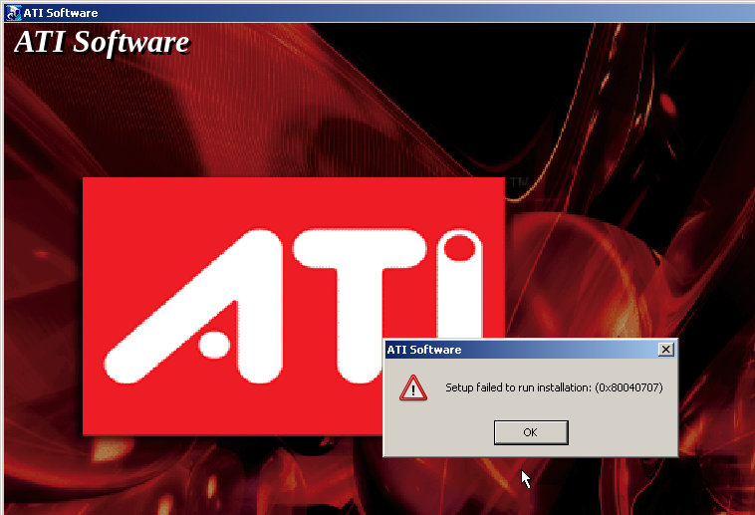
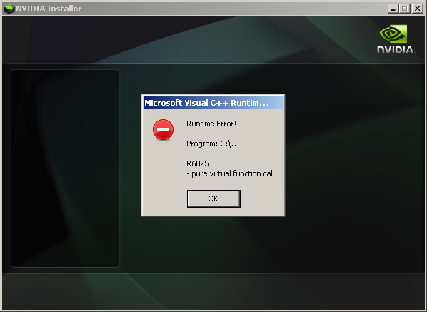
The Problem

Slide 3
The Problem
Major GPU Drivers still don‘t work under ReactOS
Testing them on Real Hardware is tedious,
and requires hardware
If there only was a way to debug this like a VM...

Slide 4
The Solution

Slide 5
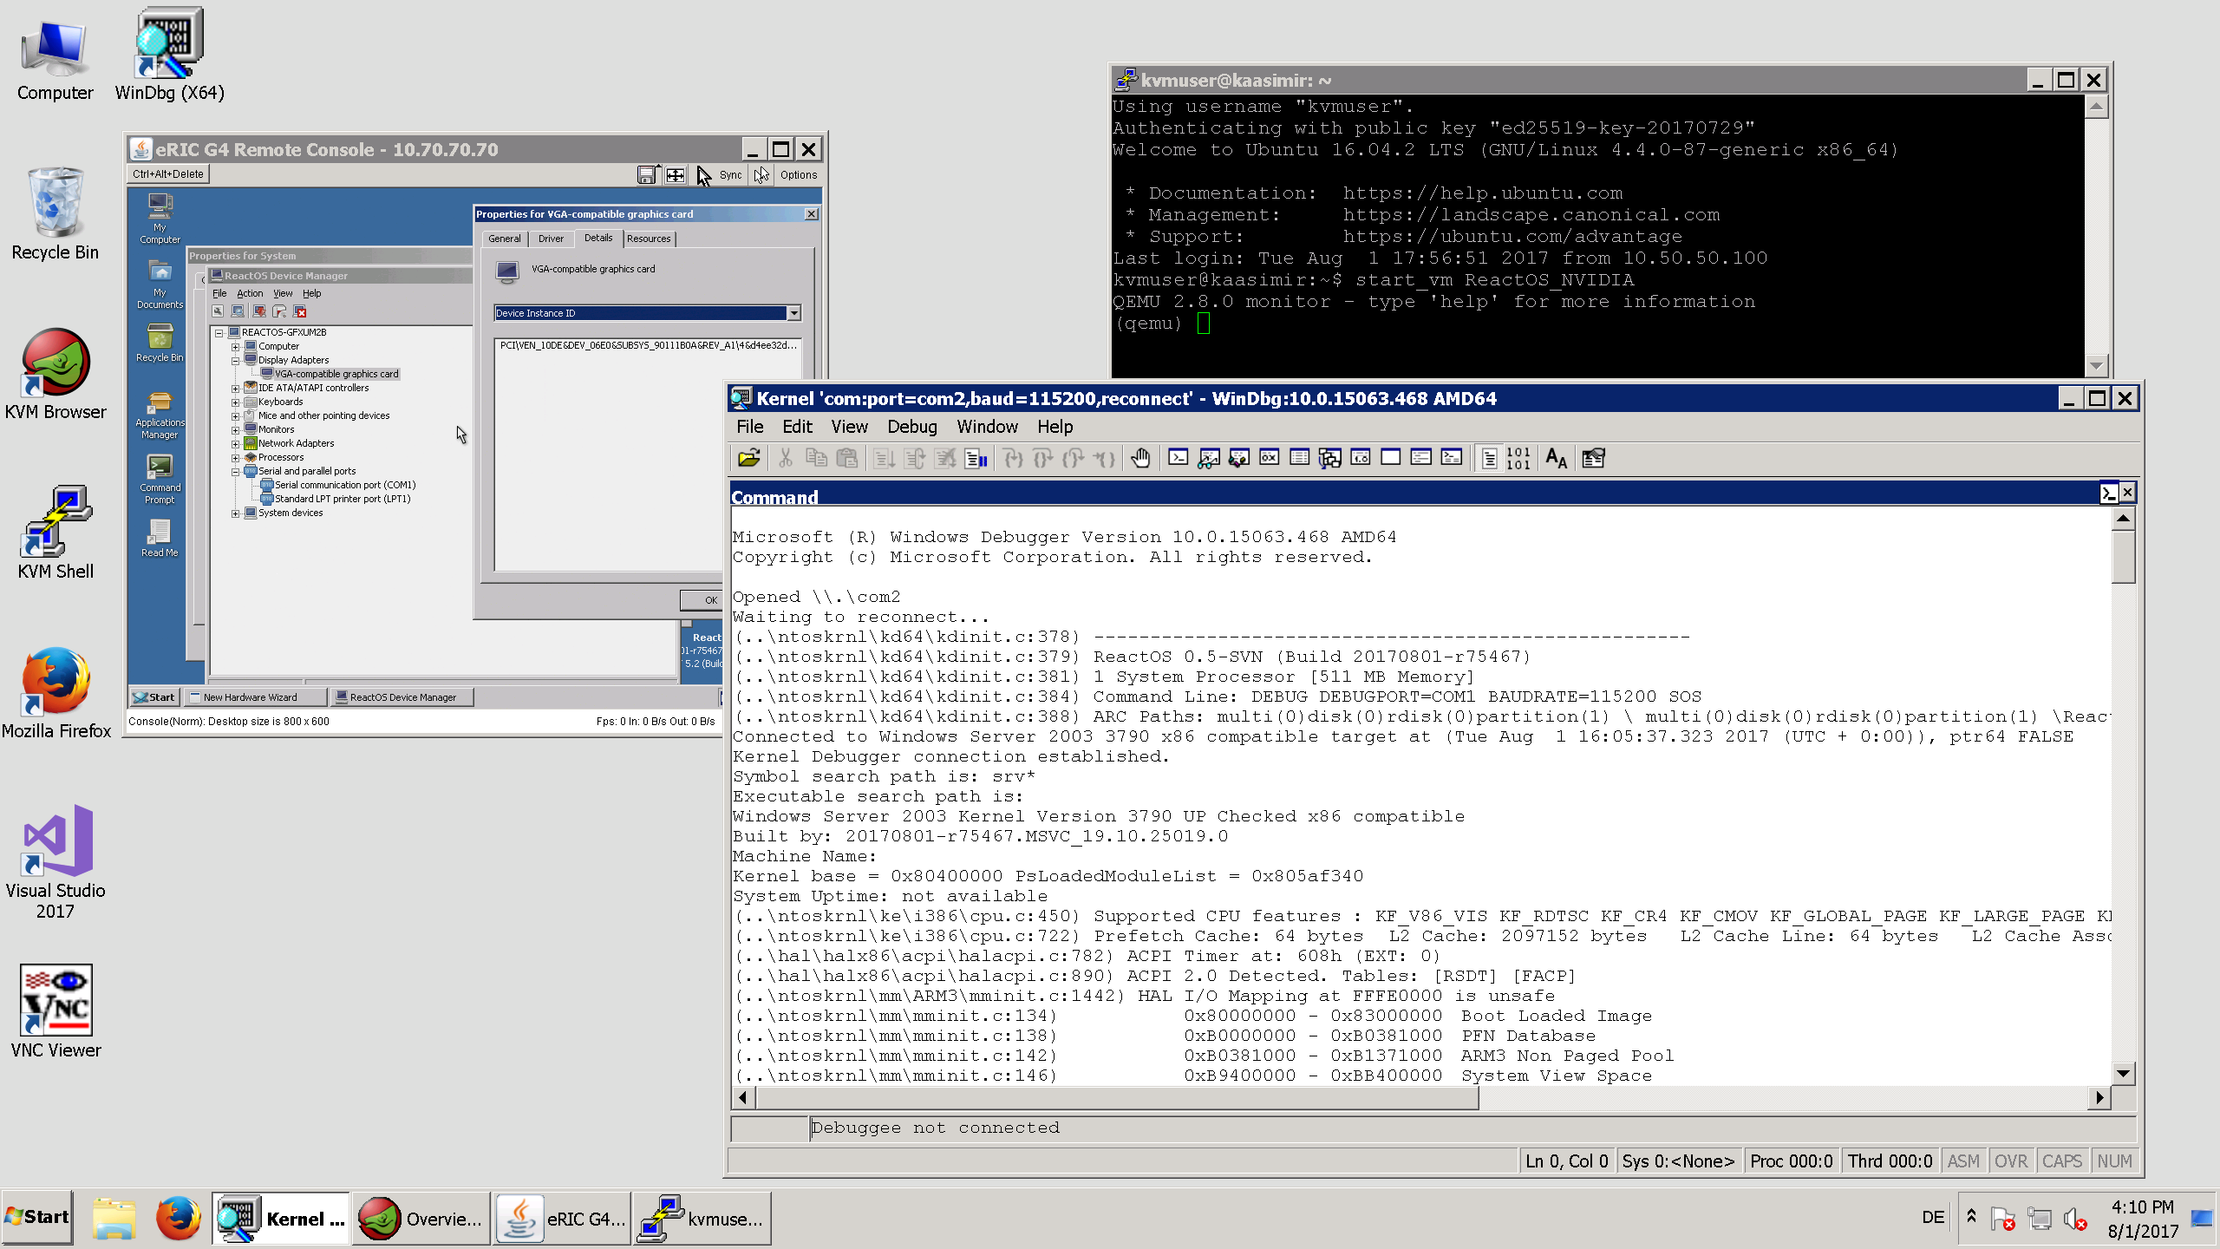

Slide 6
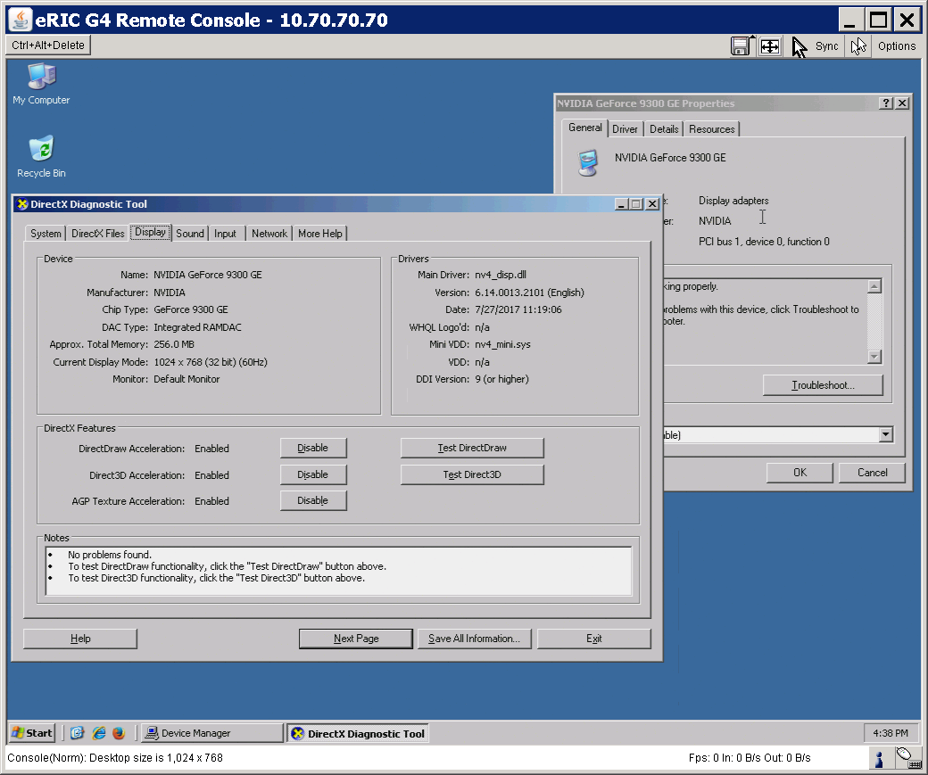
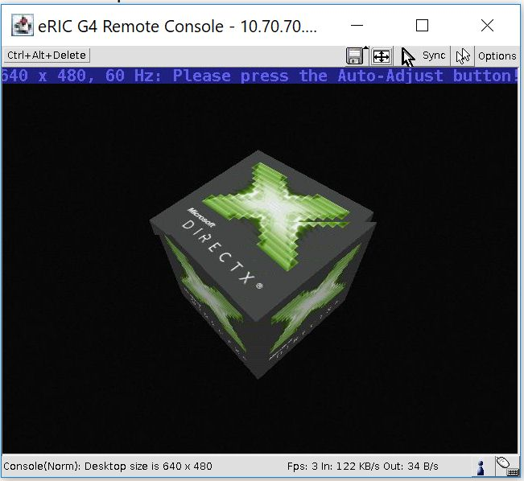

Slide 7







Windows 7
Development VM
Input, VGA
eRIC KVM-over-IP
eRIC KVM-over-IP
Serial
ReactOS
Testing VM
Windows 2003
Testing VM
Windows 2003
Testing VM
ReactOS
Testing VM
Windows 2003
Testing VM
ReactOS
Testing VM
RDP
Shared Folder
ISO Image
AMD GPU
NVIDIA GPU
Ubuntu 16.04 LTS with QEMU/KVM 2.8 Hypervisor
Kaasimir Server
(standard x64 platform with Intel VT-d support)

Slide 8
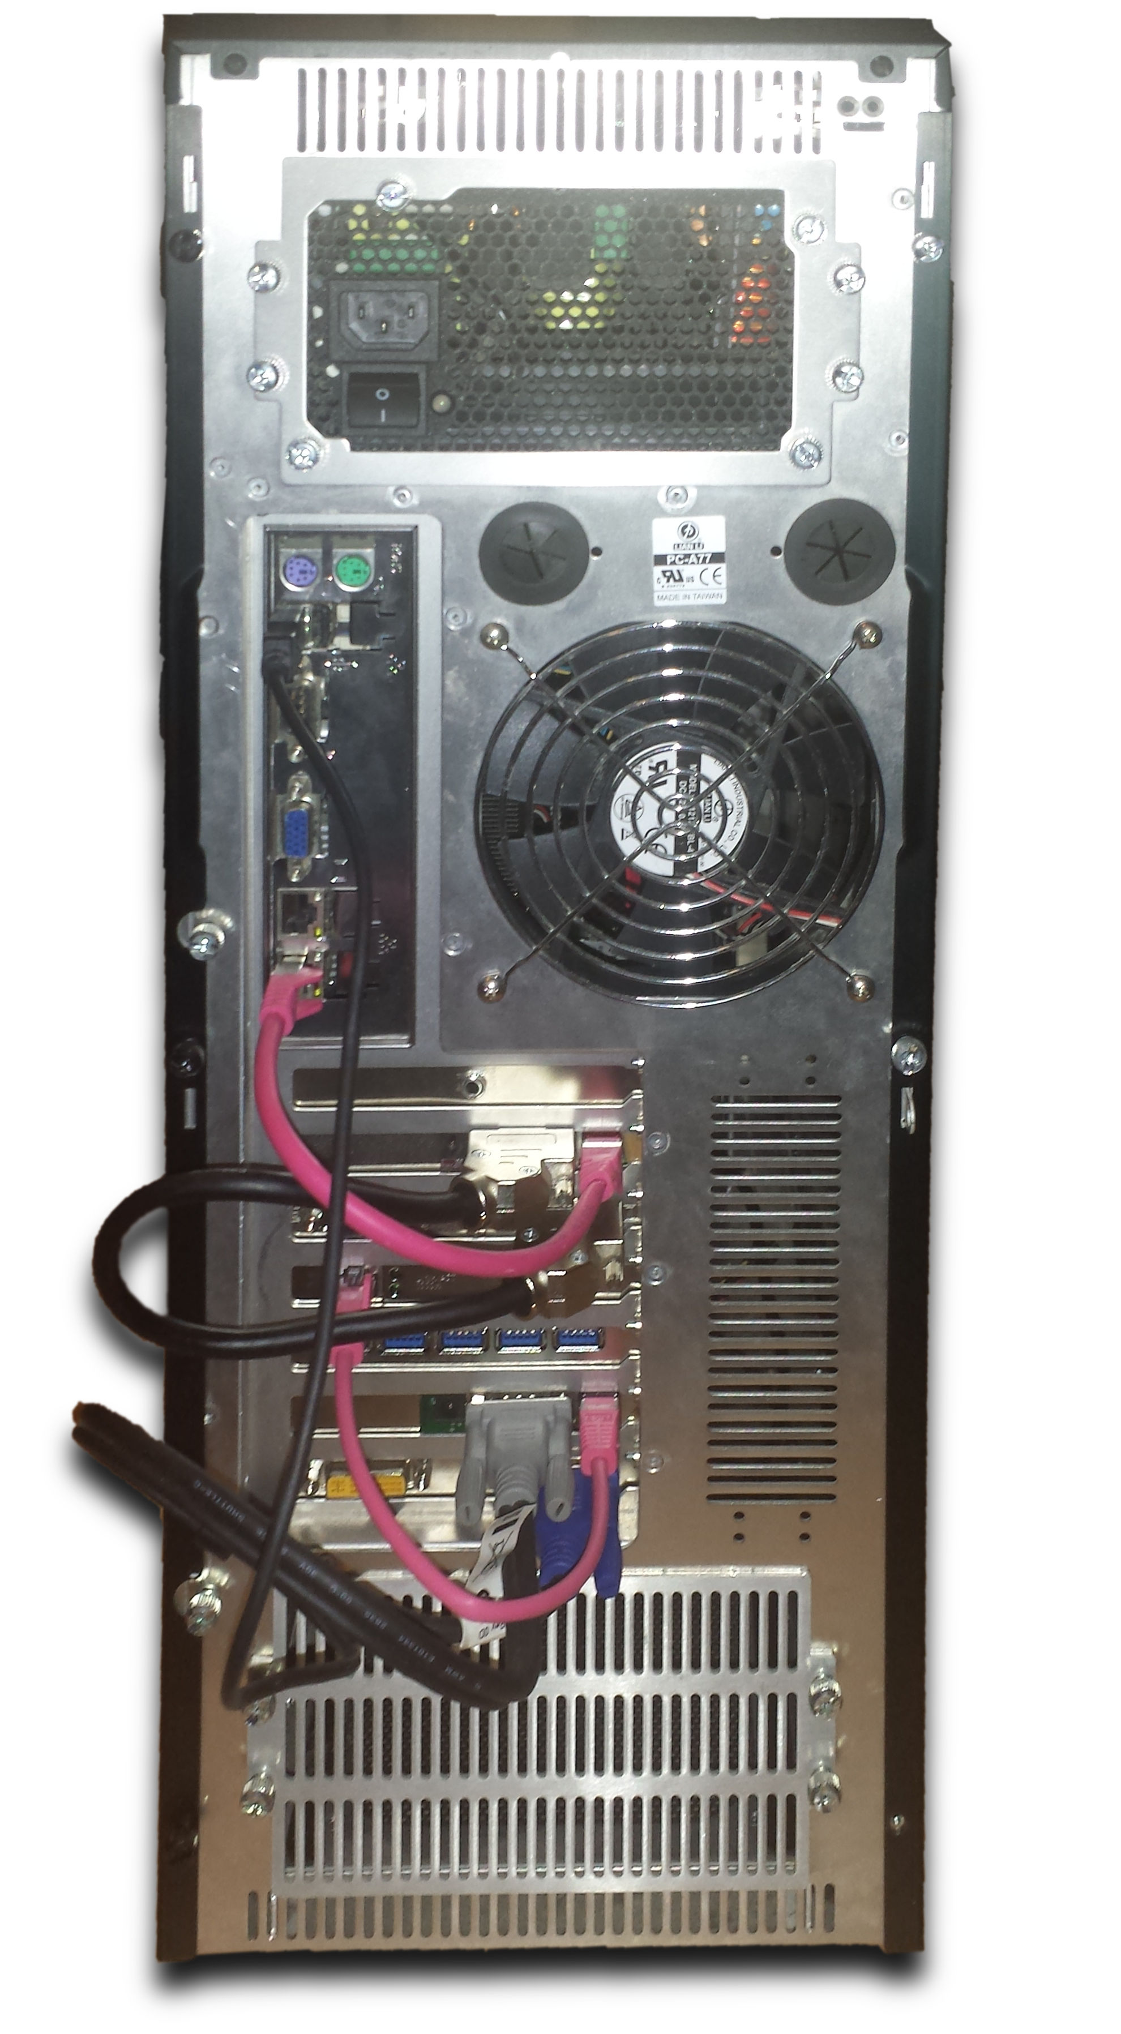
Finally an answer to the question why you ever need 7 expansion slots ;-)

Slide 9
Other Use Cases
Testing any PCIe card under ReactOS (e.g. USB 3.0)
When you just quickly need a fast build machine or Windows VMs for testing

Slide 10
Cool! So where can I find it?
Hosted privately by myself
Developers and Testers can request an account
You can even turn it on and off on demand

Slide 11
Thank you for your attention!
Questions?

Slide 12
Demonstration

Slide 13
Legal Notice
All product names, logos, and brands are property of their respective owners. All company, product and service names used in this presentation are for identification purposes only. Use of these names, logos, and brands does not imply endorsement.
AMD, ATI, the AMD Logo, and the ATI Logo are registered trademarks of Advanced Micro Devices, Inc. in the United States and/or other countries.
Direct3D, DirectX, the DirectX Logo, Windows, and the Windows Logo are registered trademarks of Microsoft Corporation in the United States and/or other countries.
eRIC is a registered trademark of Raritan Inc. In the United States and/or other countries.
GeForce, NVIDIA, and the NVIDIA Logo are registered trademarks of NVIDIA Corporation in the United States and/or other countries.
Intel is a registered trademark of Intel Corporation in the United States and/or other countries.
QEMU is a trademark of Fabrice Bellard. The QEMU Logo has been created by Benoît Canet.
The Power, Power Hard and Reset icons are taken from the Crystal Clear icon set by Everaldo Coelho.
The Tux logo has been created by Larry Ewing (lewing@isc.tamu.edu) and The GIMP.
Ubuntu is a registered trademark of Canonical.

